Slide 1
Mentoring Minority Undergraduates in their Efforts to Implement a LAMP Documentation Server for a Condor-based Grid
Linda Hayden, haydenl@mindspring.com
Jeaime Powell, jeaimehp@gmail.com
Felicia Doswell, fdoswell@nsu.edu

Slide 2
The project titled Implement a LAMP Documentation Server for a Condor-based Grid was conducted as part of the summer 2007 Undergraduate Research Experience (URE) on the campus of Elizabeth City State University (ECSU) .
URE is a summer program for underrepresented students in science, technology, engineering and mathematics (STEM) fields from ECSU and other Minority Serving Institutions (MSIs).
The objective of this program is to promote the professional development of minority students through their participation in research training activities.

Slide 3
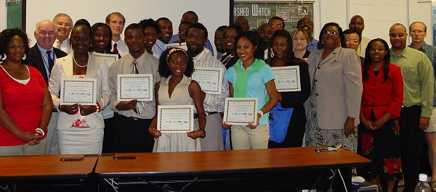
Recruitment
Both a flier announcing the program and a webpage were developed to recruit students. Particular attention was paid to recruiting students from minority serving institutions with limited research capabilities. Recommendations from faculty members at MSIs and from past program participants provide an important recruitment tool for more than 80% of the applicant. The program began in 2001.
Number of participants to date: 105
Number of underrepresented participants to date: 103
Percentage of students going on to graduate school after the B.S. degree: 72%

Slide 4
Structure of the URE program
Each student in the program is assigned to a specific research team, where they work closely with the faculty and staff.
In addition, seminars, lunch meetings, and social functions are organized to facilitate undergraduate interaction.
The project is conducted for eight weeks during the summer, with on-line mentoring and follow-up during academic year.
During the first week of the program all students learn skills related to use of the laboratory software and hardware resources. Students also learn skills that allow them to document their experience on the team website.
During the remaining seven weeks of the program students are assigned to teams working on research projects as assigned by the team mentor

Slide 5
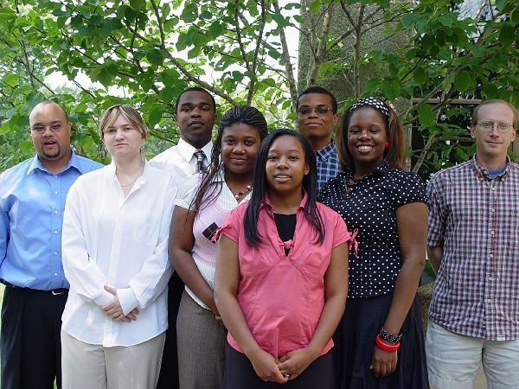
Mentors
CERSER research associates and staff have provided mentorship for teams. Dr. Malcolm LeCompte, Dr. Eric Akers, Mr. Jeff Wood and Mr. Jeaime Powell have been the primary source of mentors for teams with research related to cyberinfrastructure applications to ice sheets and polar research.
Indiana University representative,
Dr. Marlon Pierce worked closely with the LAMP Documentation Team.

Slide 6
Past team projects have included the following:
• Generation of Titanic Prime Numbers Through High Performance Computing Infrastructure
• A Comparative Analysis of Localized Command Line Execution, Remote Execution through Command Line, and Torque Submissions of Matlab(R) Scripts for the Charting of CReSIS Flight Path Data
• Visualization of the 1993-2007 CReSIS Greenland Data Sets for the Polar Grid High Performance Computing System
• Creation of a Flexible and Scalable Distributed Computing Infrastructure Using OpenGRID Project Standards
• A Comparision of Job Duration Utilizing High Performance Computing on a Distributed Grid
• Implementation of a Static Based Cluster 3
• The Utilization of Polar Grid Resources to Analyze, Process, and Display Data from the National Data Buoy Center
• Determining the Antarctic Ice Sheet Grounding Line with Photoclinometry using LANDSAT Imagery and ICESat Laser Altimetry

Slide 7
This paper describes efforts to lead underrepresented undergraduate students as they setup a documentation platform for a Condor-based GRID to be established at Elizabeth City State University.
Project selection was based on the following:
• Need to provide an entry level a project suitable for sophomore and junior level computer science majors.
• Need to establish a documentation platform for a Condor-based GRID at Elizabeth City State University.
• Need to prepare for a 4-node, Condor-based GRID using the documentation server created to record future procedures.

Slide 8
LAMP server is a type of software bundle found in a specific server. LAMP stands for Linux, Apache, MySQL, and PHP. The P can also stand for Perl or Python but generally it is assumed to be PHP. It is a solution stack of software programs, commonly open-source programs, used together to run dynamic websites or servers. Linux is the operating system.
Apache is the web server used.
MySQL is the database management system.
PHP, Perl, or Python is used as the programming language for the system.
Though the originators of these open source programs did not design them all to work specifically with each other, the combination, has become popular because of its low acquisition cost and because of the ubiquity of its components (which come bundled with most current Linux distributions).

Slide 9
APACHE
Robert McCool created the first Apache web server. He was involved with the National Center for Supercomputing Applications web server, also known as NCSA HTTPd. Apache is primarily used to serve both static content and dynamic Web pages on the World Wide Web. Since April 1996 Apache has been the most popular HTTP server on the World Wide Web. Apache is developed and maintained by and maintained by an open community of developers under the auspices of the Apache Software Foundation.
Lessons Learned
• Locating suitable version of Apache on www.apache.org and installing it on the grid. Unzipping and extracting the files.
• Understanding the administrative privileges required to install and to use sudo code.
• Use of Linux commands and directories including ./configure –enable-so, config.log sudo ./make
• Use of c compilers within the terminal window.

Slide 10
MySQL
MySQL is a multithreaded, multi-user SQL database management system. MySQL is a key part of LAMP, and a fast growing open source enterprise software stack. More and more companies are using LAMP as an alternative to expensive proprietary software stacks because of its lower cost and freedom from lock-in. It was first released internally on May 23,1995, but it wasn’t until January 8, 1998 that the version for Windows 95 and NT was released. More releases of the beta version have been made and distributed to various locations. Libraries for accessing MySQL databases are available in all major programming languages with language-specific API’s.
Lessons Learned
•Installing system packages in preparation for PHP and Linux usage.
•Use of Linux commands and directories including $ sudo apt-get install php5 $sudo /etc/inti.d/apache2 $ <?php phpinfo();?> and $sudo apt-get install php5-xsl php5-gd php-pear
•Use of the command line terminal of the Linux operating system.

Slide 11
MediaWiki
MediaWiki derives from the word “wiki”, which is a web application designed to allow multiple authors to create, remove, and edit web page content using a web browser. The multiple author capacity makes them effective tools for mass collaborative authoring. One of the best-known is the online encyclopedia called Wikipedia. Also, the term refers to the collaborative software used to create such a website, known as Wiki Software, which is usually implemented as a script that runs on a web server with the Wiki content stored in a relational database management system such as MySQL. The first Wiki Software was created back in 1995.
Lessons Learned
•Download (http://www.mediawiki.org/wiki/Download)
•Uncompressing and untar of files On Ubuntu/Linux OS using command: tar xvzf mediawiki- *.tar.gz
•Use of Linux commands and directories including $ cd /var/www, $ udo chown -R apache:apache /var/www/wiki/*
• Checking environment and reporting installation problems.
• Site configurations including Name, contact, language, password, superuser accounts, language, and database configurations.

Slide 12
Ubuntu
Under the umbrella of Linux falls Ubuntu. Ubuntu is an African word meaning “Humanity to others”, or “I am what I am because of who we all are”. The Ubuntu distribution is known for “bringing the spirit of Ubuntu to the software world. ”Ubuntu is a free of charge, community developed operating system that is designed for laptops, desktops and servers. buntu 7.04—also known as Feisty Fawn—is known for its reliable software management tools and catalog of ready- to-install free software applications.
Ubuntu contains the applications needed for such as word processing, email applications, web server software, and programming tools. Every six month a new desktop server is released as well free security updates for eighteen months.
Lessons Learned
• Understanding that Server Edition of Ubuntu is built on the solid foundation of Debian which is known for its strong server installations and reliable performance.
• Use of Ubuntu’s Open Office which contains a user interface
• Creating partitions on the hard disk

Slide 13
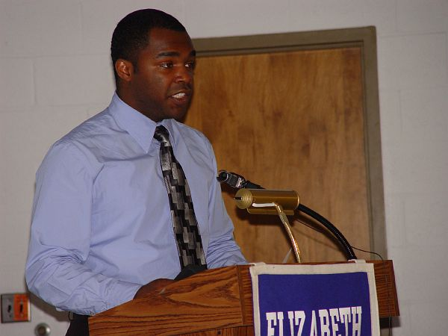
Professional Development
• Distinguished Lectures including:
Dr. Marlon Pierce, Community Grids Laboratory Indiana University
Dr. Omar Ali, NASA Langley Research Center, and Dr.
Dr. Arvin Agah, CReSIS project University of Kansas
• Preparation for graduate school seminars
• Seminars on how to format research papers
• Paid membership in the Geoscience and
Remote Sensing Society
• Oral and Written Team Research
Report Presentations

Slide 14
REFERENCES
[1] “Lamp- How To”, Retrieved from http://lamphowto.com
[2] “Ubuntu” Retrieved from http://www.ubuntu.com/
[3] “The Apache HTTP Server Project” Retrieved from http://httpd.apache.org/
[4] “The Apache Software Foundation (ASF)” Retrieved from http://httpd.apache.org/
[5] “MySQL AB”, Retrieved from http://mysql.com/
[6] “PHP Hypertext Processor”, Retrieved from http://www.php.net/
[7] “MediaWiki”, Retrieved from http://www.mediawiki.org/wiki/MediaWiki
[8] “Blogger”, Retrieved from Webhttp://www.blogger.com/
[9] “Del.icio.us”, Retrieved from http://del.icio.us/
[10] “Globus Toolkit”, Retrieved from http://www.globus.org/toolkit/

Slide 15
